Slide 1
Weekly Meeting (# 6)
TEA; PME; NTHU;
Good Afternoon Everyone
Bayesian inverse acoustic reconstruction using the particle filters- Multiple sources amplitude and location estimation.
Code Finalization and Simulation:
Joint state vector of amplitudes and locations of multiple sources.
Prior Distribution modified accordingly in weight update equation.
Appropriate comments added in the code.
Contour Plots for the desired and reconstructed normal surface velocity.
Comparison with the velocity contour plots with fixed but perturbed source locations.
JASA Paper – Abstract completed, Introduction half completed.
Friday, June 29, 2012

Slide 2
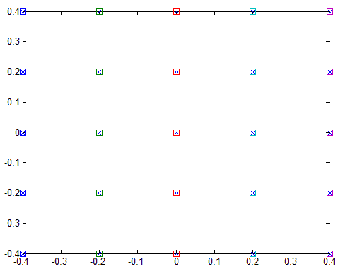
2-dimensional array depicting the mean virtual source points and microphones.
Number of Particles = 100

Slide 3
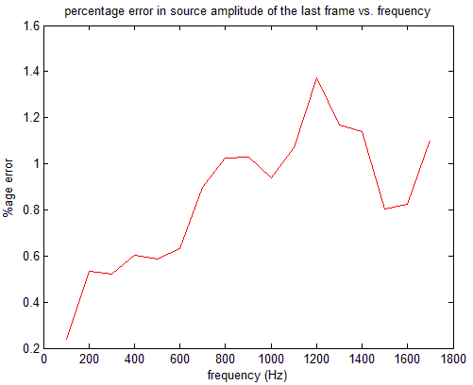
Friday, June 29, 2012
TEA; PME; NTHU;
3/11

Slide 4
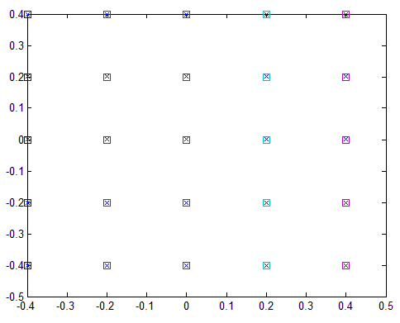
2-dimensional array depicting the estimated virtual source points (at 1000Hz and last frame) and microphones.
Friday, June 29, 2012
TEA; PME; NTHU;
4/11

Slide 5
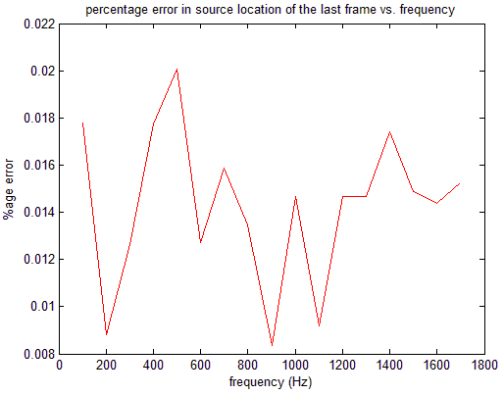
Friday, June 29, 2012
TEA; PME; NTHU;
5/11

Slide 6
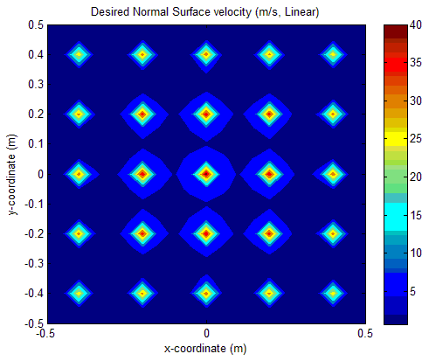
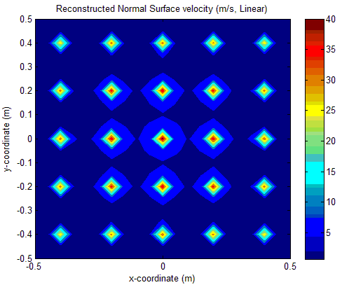
Friday, June 29, 2012
TEA; PME; NTHU;
6/11

Slide 7
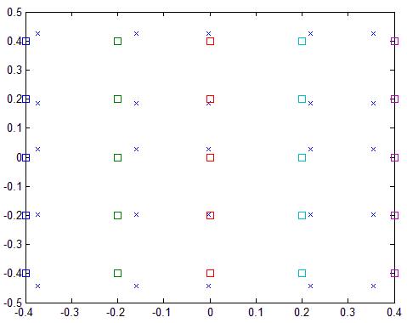
Comparison with the velocity contour plots with fixed but perturbed source locations.
Friday, June 29, 2012
TEA; PME; NTHU;
7/11

Slide 8
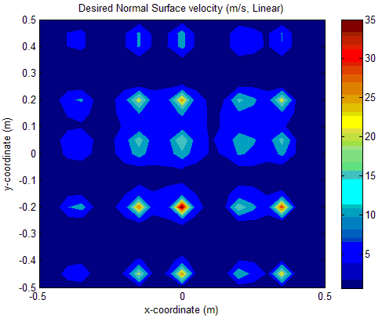
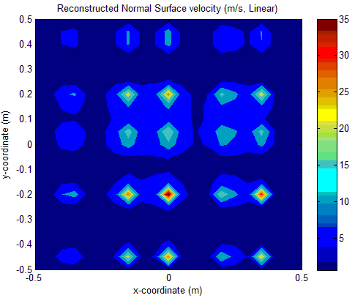
Friday, June 29, 2012
TEA; PME; NTHU;
8/11

Slide 9
Comments and Conclusions
The source localization i.e. the estimation of the position coordinates of the source can’t be done with a covariance of more than 0.0001 in any of the x or y normal distributions.
There appears to be a inverse relationship between the retreat distance and the co-variances in the normal distributions specifying the source locations. Not complying with this results in reconstruction failure.
The spread in the intensity of blue colour around the virtual source points in the reconstruction plane is evident which can be attributed as a result of randomizing the source locations from the normal distribution.
Friday, June 29, 2012
TEA; PME; NTHU;
9/11

Slide 10
Things to do next…
Complete JASA Paper.
If time permits:
Apply EM (Expectation maximization) algorithm to the same problem, compare the results with those obtained from particle filters and include it in the paper.
Friday, June 29, 2012
TEA; PME; NTHU;
10/11

Slide 11
Thank you for listening
Friday, June 29, 2012
TEA; PME; NTHU;
11/11

